Slide 1
Selecting a Project
Create Performance Task

Slide 2
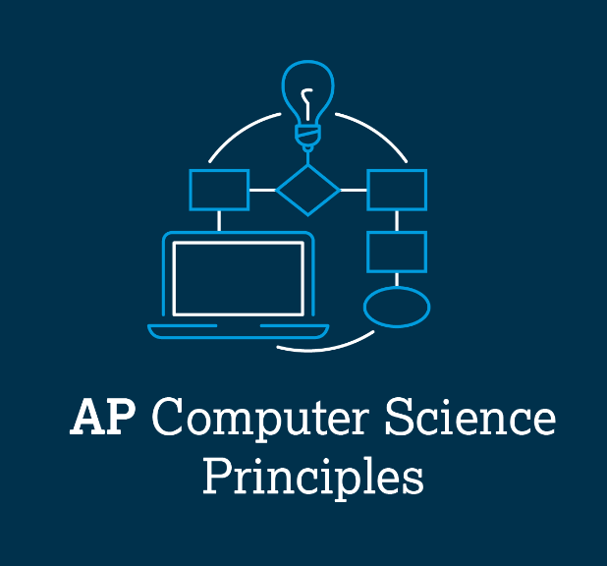
AP CSP Create Performance Task
Create PT specific requirements:
Has input (button presses)
Has output (screen, pixels, audio, etc.)
Creates a list
Uses a list in a meaningful way
Has a function with a parameter
Parameter has an effect on the functionality of the function (Parameter used in if statement)
Function has:
Selection (If statement)
Iteration (Loop)

Slide 3
AP CSP Create Performance Task
Things to remember about the Create PT:
You can work with a partner.
Your classmates can help you.
Your teacher cannot help you.
You cannot use an assigned program or Practice PT for your project, but it can be similar.
You will be given 9 hours of class time to work on the project.

Slide 4
AP CSP Create PT - Selecting a project
This lesson will help you come up with an idea for your Create PT project.
Throughout this course you have:
Created three remix projects
Completed four PT Practice programs

Slide 5
AP CSP Create PT - Selecting a project
What can your project NOT be?
You CANNOT submit a project completed for an assignment.
This includes all the PT Practice programs.
This includes your remix programs.
This includes the mission programs.
Any program you received feedback on or help from the teacher cannot be submitted as your Create Performance Task.
The teacher cannot assign you a project. You must come up with your own idea.

Slide 6
AP CSP Create PT - Selecting a project
What can your project be?
Your project can be based on, or similar to, your other programs.
The Create PT needs to be original code, or have a significant extension to a previous program.
It doesn’t need to be a huge project with lots of complicated lines of code – just something that shows what you know and meets the requirements.
It should be something you are interested in.
Your teacher can help you brainstorm ideas, but your actual project is up to you!

Slide 7
AP CSP Create PT - Selecting a project
PT Practice #1
Go to the Sandbox in CodeSpace and open PT_CodeBot_Practice1.
Review what the code does.
Review how and where the code meets the PT requirements.

Slide 8
AP CSP Create PT - Selecting a project
PT Practice #1
What the program does:
This program will keep the ‘bot inside the lines. It shows a colorful light show while turning around, and keeps track of the line hits using the LEDs.
Brainstorm some new Create PT projects, based on this one.

Slide 9
AP CSP Create PT - Selecting a project
PT Practice #1
Brainstorm Ideas (add your own ideas to the list!)
Change the light show. You could:
use the line sensor lights instead of user lights
use decimal numbers for the lights instead of binary
play a song instead of beeps
have more than one list for beeps and lights, and randomly select which one to use

Slide 10
AP CSP Create PT - Selecting a project
PT Practice #1
Brainstorm Ideas (add your own ideas to the list!)
Have different turns
The back turn function does the same thing every time. Create different ways to turn around. Which sensor is hitting the line? That could determine which way to turn. Or select a random turn.
The ‘bot always moves forward in a straight path at the same speed. Give some variation to the forward movement.

Slide 11
AP CSP Create PT - Selecting a project
PT Practice #1
Brainstorm Ideas (add your own ideas to the list!)
Give the ‘bot a purpose: Have it escape the box!
Instead of just moving forward, have the ‘bot systematically check the lines until it doesn’t find a line. Then it knows how to escape the box!

Slide 12
AP CSP Create PT - Selecting a project
PT Practice #2
Go to the Sandbox in CodeSpace and open PT_CodeBot_Practice2.
Review what the code does.
Review how and where the code meets the PT requirements.

Slide 13
AP CSP Create PT - Selecting a project
PT Practice #2
What the program does:
This program has the ‘bot perform an animation by counting guests and then walking the runway, spinning, and playing a song.
Brainstorm some new Create PT projects, based on this one.

Slide 14
AP CSP Create PT - Selecting a project
PT Practice #2
Brainstorm Ideas (add your own ideas to the list!)
Make the animation different or more elaborate.
Use two buttons. Each one can have the ‘bot perform a different animation.
Use the play_song() function more frequently with different songs, not just at the end of the animation.
Use cute_beeps() more frequently.

Slide 15
AP CSP Create PT - Selecting a project
PT Practice #2
Brainstorm Ideas (add your own ideas to the list!)
Add more actions for the ‘bot. Right now the ‘bot only moves forward and spins.
Count something other than guests. For example, count each time it detects a line. After 5 detections, perform an animation. Then start over again.
Perform an animation, but check for a line as it performs. If the ‘bot gets too close to an “edge”, have it do something else.

Slide 16
AP CSP Create PT - Selecting a project
PT Practice #3
Go to the Sandbox in CodeSpace and open PT_CodeBot_Practice3.
Review what the code does.
Review how and where the code meets the PT requirements.

Slide 17
AP CSP Create PT - Selecting a project
PT Practice #3
What the program does:
This program moves the ‘bot in a square, either turning to the right or turning to the left.
Brainstorm some new Create PT projects, based on this one.

Slide 18
AP CSP Create PT - Selecting a project
PT Practice #3
Brainstorm Ideas (add your own ideas to the list!)
Add more lists for a different shape. Use a button for a square, and a button for a different shape, like rectangle or triangle.
Have the same turn (right or left), but change the size of the square. A longer delay makes a bigger square. A shorter delay makes a smaller square.

Slide 19
AP CSP Create PT - Selecting a project
PT Practice #3
Brainstorm Ideas (add your own ideas to the list!)
Have one button move the ‘bot in a square, but the other button has the ‘bot do something else, like follow a line or perform an animation or play a song.

Slide 20
AP CSP Create PT - Selecting a project
PT Practice #4
Go to the Sandbox in CodeSpace and open PT_CodeBot_Practice4.
Review what the code does.
Review how and where the code meets the PT requirements.

Slide 21
AP CSP Create PT - Selecting a project
PT Practice #4
What the program does:
This is a line follower program. The ‘bot will detect and follow a line after calibration.
Brainstorm some new Create PT projects, based on this one.

Slide 22
AP CSP Create PT - Selecting a project
PT Practice #4
Brainstorm Ideas (add your own ideas to the list!)
Add more features to the code:
Add beeps when the ‘bot is too far to the right or left
Add flashing lights while moving
Play a song while moving

Slide 23
AP CSP Create PT - Selecting a project
PT Practice #4
Brainstorm Ideas (add your own ideas to the list!)
Add a timer feature. After a set amount of time, have the ‘bot stop, do something (play song, beep, spin), and then continue following the line.
Add a counter. It could count button presses, center line detection, etc. After the counter reaches a number, have the ‘bot do something else.

Slide 24
AP CSP Create PT - Selecting a project
PT Practice #4
Brainstorm Ideas (add your own ideas to the list!)
Have the line end. When the line ends, the ‘bot spins until it finds the line again, and then it follows the line, going the other direction.

Slide 25
AP CSP Create PT - Selecting a project
Remix project and missions
Open a remix project that you really enjoyed.
What Create PT requirements does it already meet?
What can you add to it to meet all the requirements?
How can you modify the program to add new functionality?

Slide 26
AP CSP Create PT - Selecting a project
Remix projects
When you started a remix, you brainstormed possible project ideas.
The remix slides also gave some suggestions.
You can review suggestions from the three remix project slides for more ideas.

Slide 27
AP CSP Create PT - Selecting a project
You should fully understand the requirements of the Create PT and are ready to start brainstorming an idea for your project.
You will be given class time to complete the project.
You should be able to complete the code in 7 hours (don’t make it too complicated).
Then you will have 2 hours for the Digital Portfolio.
No new programming skills – This isn’t the time to learn something new.
Stick with what you already know and make it work.

Slide 28
AP CSP Create PT - Selecting a project
Pick a project that:
Is personally relevant – a project you are interested in.
Can meet all the requirements of the Create PT.
It is helpful if the project:
Has a clear purpose and function.
Has a clear intended user.

Slide 29
AP CSP Create PT - Selecting a project
Final Comments
Don’t use any code that you don’t understand. The Create PT is all about the writing. If you can’t explain it, don’t use it.
Work with a partner! Do equal work, and make sure you both understand the code.
You can get feedback and help from your peers. That means all the students in your class, but no one else.
DO NOT ask the teacher for any help, other than technical, during the Create PT class hours.

Slide 30
AP CSP Create PT - Selecting a project
Final Comments
Have a plan.
You can use the remix planning guide, or any other organizer, to help you.
Get the basics done first. Make sure you have input, output and a list.
Go step-by-step. Test as you go, and debug frequently.
Then, if you have time, add more functionality.

